Slide 1
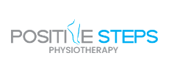
Brain Injuries in Adults

Slide 2
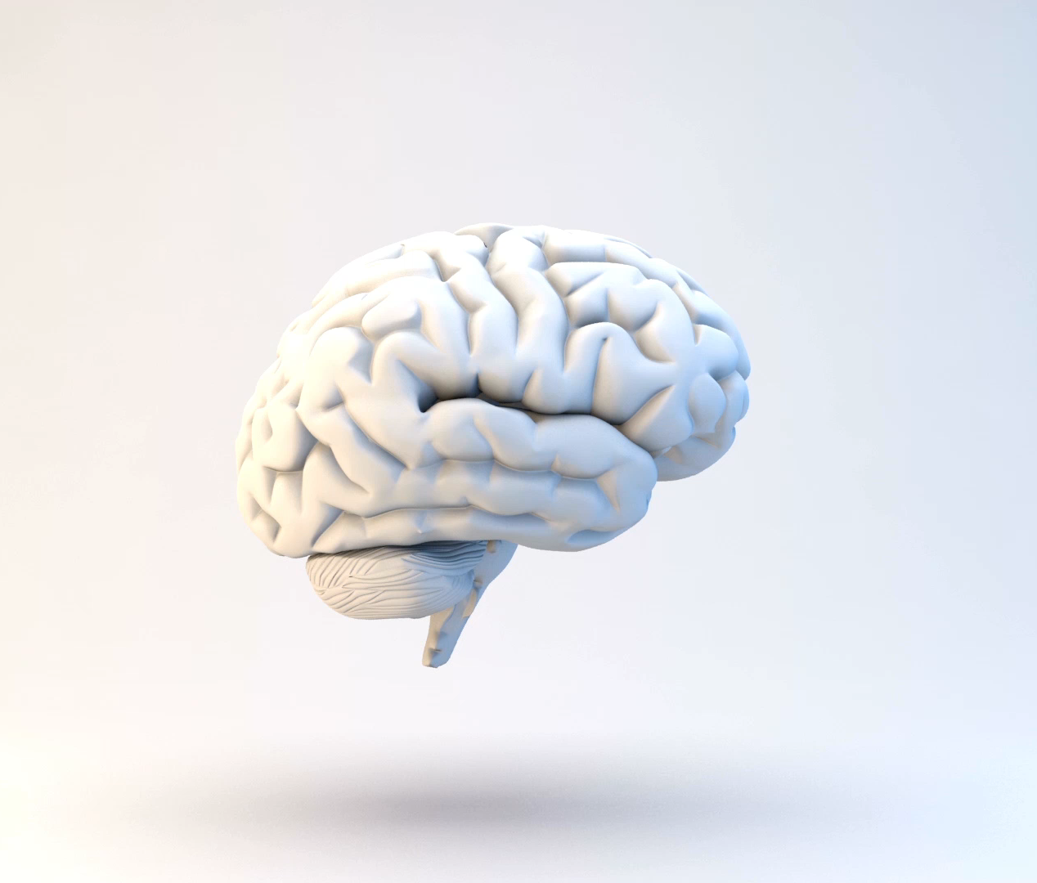
What is a Brain Injury?
An acquired brain injury (ABI) is an injury caused to the brain after birth. There are many possible causes including a fall, a road accident, tumour and stroke.
There are several types of brain injuries that vary due to cause, leading to different effects and symptoms.
Notes:
Headway - REF

Slide 3
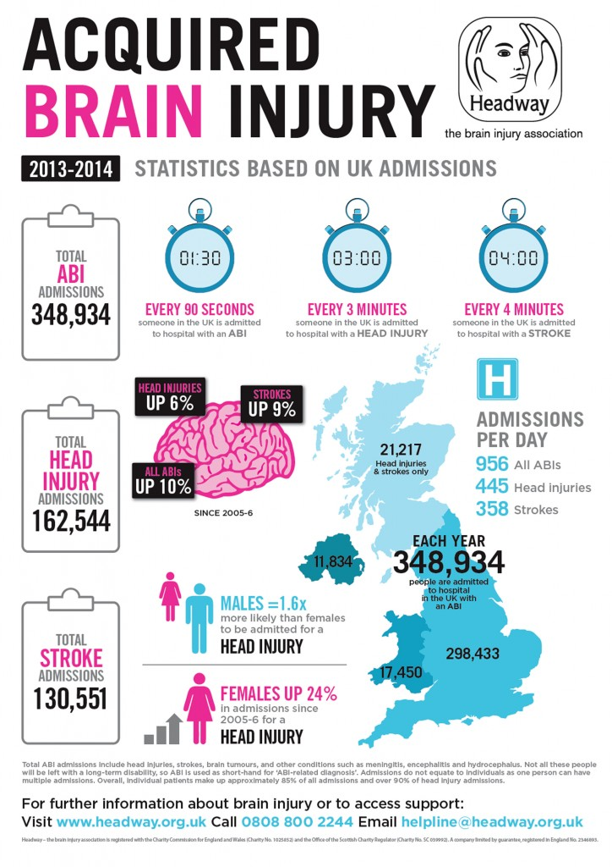
Statistics of Brain Injuries in the UK
Notes:
REF – Headway What is ABI or Acquired Brain Injury? (seriousinjuryhelpline.co.uk)

Slide 4
Types of Brain Injuries
Traumatic
Non-traumatic
A traumatic brain injury (TBI) is change in brain function due to excessive external force. Often caused by a blow, bump or jolt to the head.
Severity of TBIs range from mild (slight change in consciousness or mental state) to severe (extended period of unconsciousness or amnesia) . These symptoms can result in short- or long-term difficulties with independent function.
Non-traumatic brain injuries is change in brain function due to internal factors not the external force to the head.
While TBIs only affects concentrated areas of impact, non-traumatic brain injuries impact cells throughout the brain by attacking the cellular structure.
Common causes: Stroke, aneurysm, tumour, drug abuse, infectious disease affecting the brain (I.E., meningitis) and lack of oxygen supply to the brain (I.E., Heart attack)
Notes:
Shepard Center - REF

Slide 5
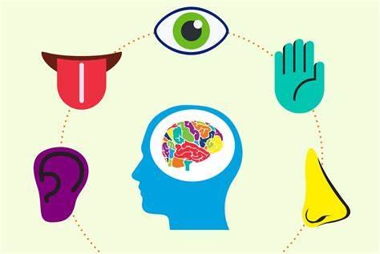
Symptoms of mild brain injuries
Physical
Sensory
Cognitive
Headache
Nausea/vomiting
Fatigue
Problem with speech
Dizziness
Difficulty sleeping
With/without loss of consciousness
Blurred vision
Ringing in ears
Bad taste in mouth
Sensitivity to light/sound
Memory/concentration deficits
Irritability
Feelings of depression and anxiety
Fatigue
Mood swings
State of confusion/disorientated
Notes:
REF - Physiopedia

Slide 6
Symptoms of moderate/severe brain injuries
Physical
Sensory
Cognitive
Loss of consciousness for several minutes
Persistent headache
Repeated vomiting
Seizures
Sudden swelling or bruises behind ears
Irregular breathing
Difficulty speaking
Blurred vision
Double vision
Ringing in ears
Bad taste in the mouth
Sensitivity to light/sound
Coma/other disorders of consciousness
Profound confusion
Irritability
Fatigue
Sad/depressed mood
Agitation
Notes:
REF - Physiopedia

Slide 7
Physiotherapy management of brain injuries
Mid phase:
Assisting in functional recovery through practice of daily tasks. Examples include reach to grasp of a cup of tea and eating food.
Strengthening/stretching, walking re-education, pain management and education for family/care givers on how to help.
Extended phase:
Strengthening weak muscles to change adopted movements.
Focusing on returning to work, education on when to seek advice and what communities/charities there are to help.
Postural/balance support programmes delivered by specialist therapists and team.
Increasing stamina for day-to-day activities such as walking to the park/shop.
Notes:
REF - Physiopedia

Slide 8

Medical management of brain injuries
Anti-epileptic drugs
Diuretics
Coma-inducing drugs
Those who experience a moderate to severe brain injury are at risk of having seizures within the first week post-injury.
To combat any further brain damage caused by a seizure, anti-epileptic drugs prevent this.
Diuretics reduce the amount of fluid in tissues and increase urine output. Therefore, helps reduce the pressure on the brain.
Those with severe brain injuries may be put into temporary comas. As a comatose brain needs less oxygen to function and reduces the pressure in the brain.
Notes:
REF – Mayo clinic and physiopedia

Slide 9
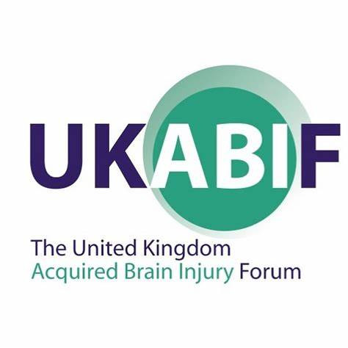
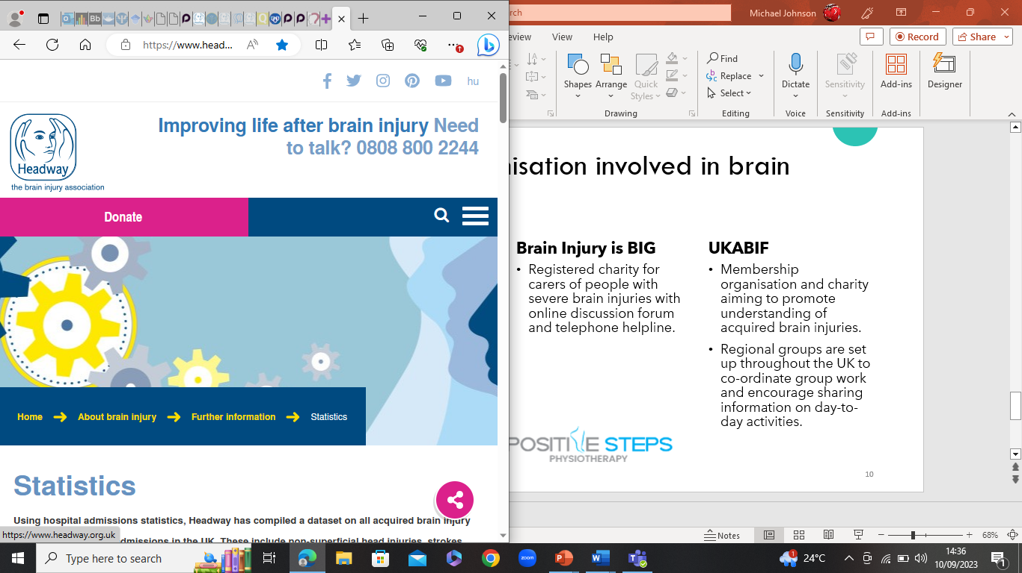
Charities/organisation involved in brain injuries
Headway
Brain Injury is BIG
UKABIF
UK charity for TBI detailing on different aspects of TBI and its rehabilitation.
Website has multiple resources to help those affected.
Registered charity for carers of people with severe brain injuries with online discussion forum and telephone helpline.
Membership organisation and charity aiming to promote understanding of acquired brain injuries.
Regional groups are set up throughout the UK to co-ordinate group work and encourage sharing information on day-to-day activities.

Slide 10
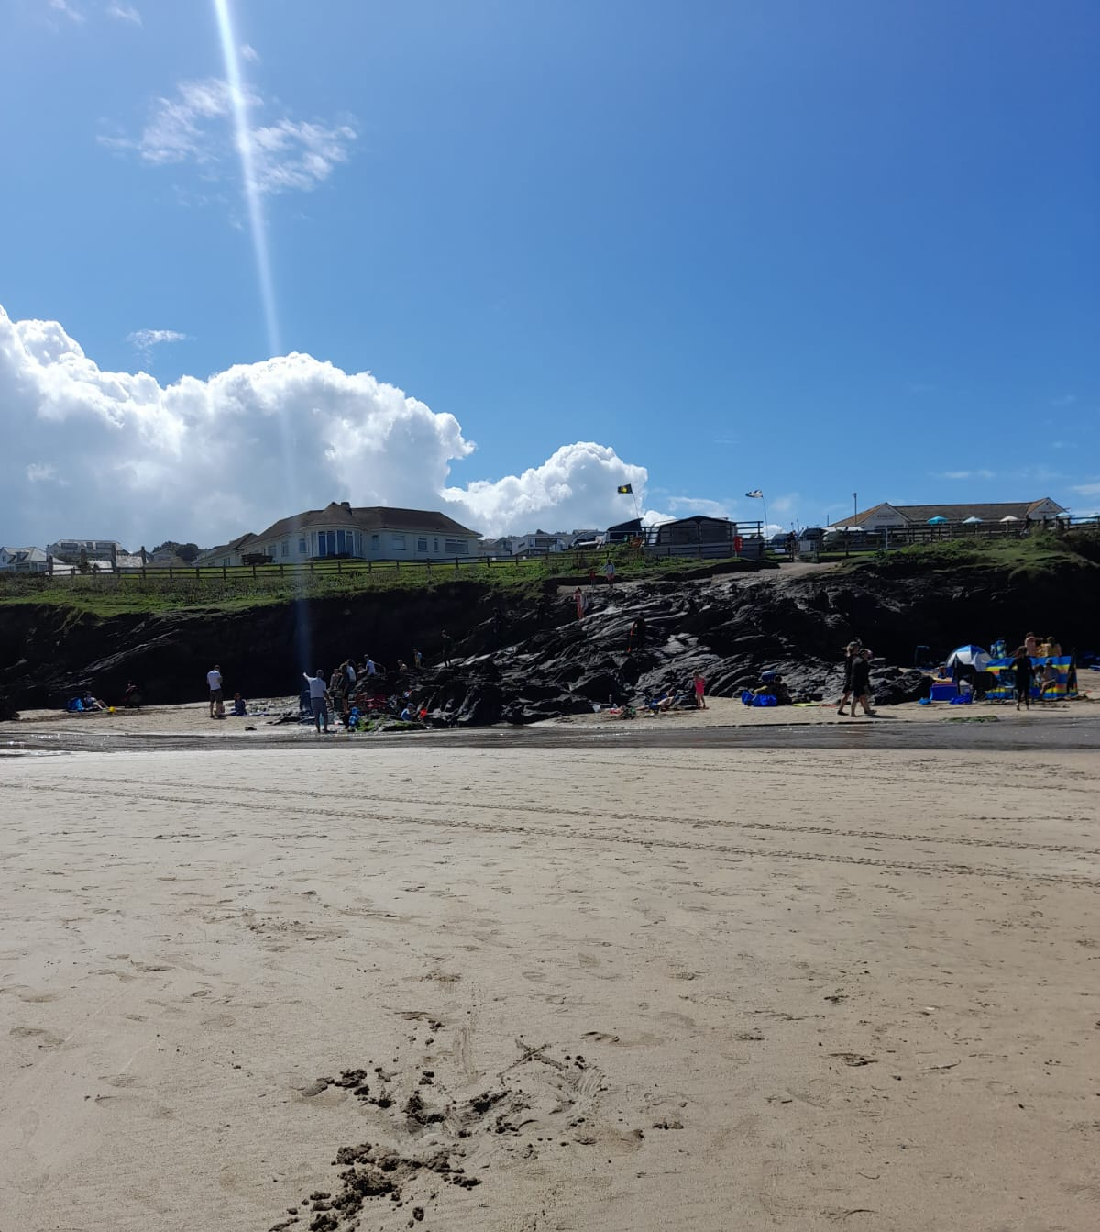
Client stories/testimonies
Walk up the Wrekin - Blog
Rocky Road
The blog explains our client's life changing experience of completing the Wrekin hike in Staffordshire. Please give it a read to understand what you are truly capable of.
Positive Steps Physiotherapy - - When our clients challenge themselves
A success story to shout about. A client who sustained a TBI in a road traffic accident and relearnt how to walk has just climbed these rocks whilst on holiday to get from her motor home to the beach. Spending precious time with her grandchildren making lots of memories!

Slide 11
Resources
https://www.headway.org.uk/about-brain-injury/further-information/statistics/
https://www.biausa.org/brain-injury/about-brain-injury/nbiic/what-is-the-difference-between-an-acquired-brain-injury-and-a-traumatic-brain-injury
https://www.shepherd.org/patient-programs/brain-injury/about
https://www.headway.org.uk/about-brain-injury#:~:text=Some%20of%20the%20most%20common%20types%20of%20brain,loss%20of%20oxygen%20to%20the%20brain%29%20More%20items
https://www.physio-pedia.com/Overview_of_Traumatic_Brain_Injury#
https://www.braininjurygroup.co.uk/living-with-brain-injury/supporting-people-with-brain-injury/support-groups-charities/
https://www.seriousinjuryhelpline.co.uk/abi-acquired-brain-injury
https://www.physio-pedia.com/Physiotherapy_Management_of_Traumatic_Brain_Injury
https://www.headway.org.uk/about-brain-injury/individuals/rehabilitation-and-continuing-care/rehabilitation/

